Slide 1
LECTURE 14 Introduction to Combinatory
Notes:
Combinatorics – The study of arrangements of objects

Slide 2
What you will learn in this lecture:
Basic counting principles
The principle of inclusion-exclusion
Pigeonhole principle
Permutations
Combinations
Generalized permutations
Generalized combinations
2

Slide 3
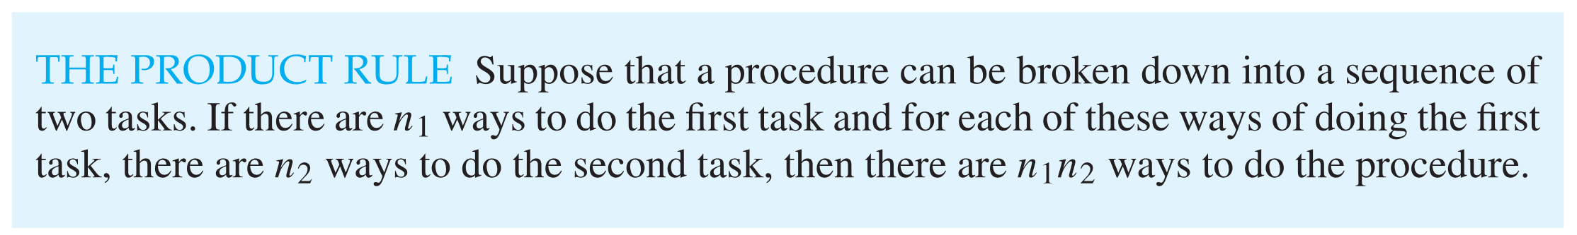
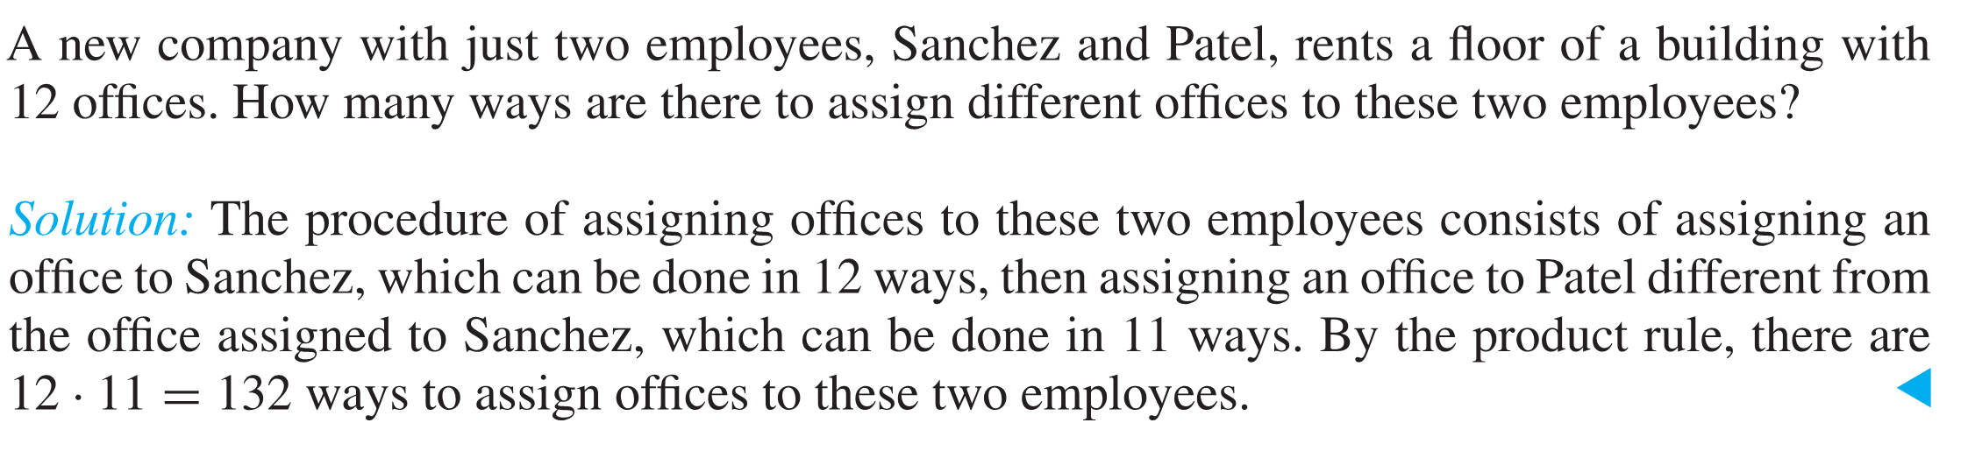
The Product Rule
Example 1

Slide 4
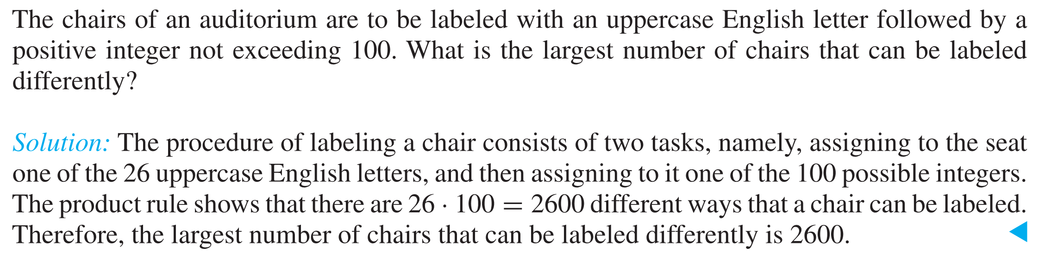
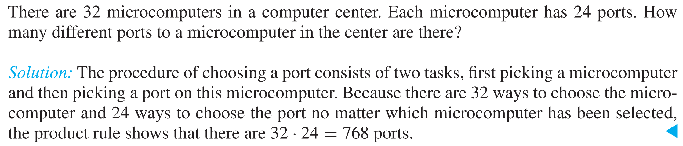
Example 2
Example 3

Slide 5
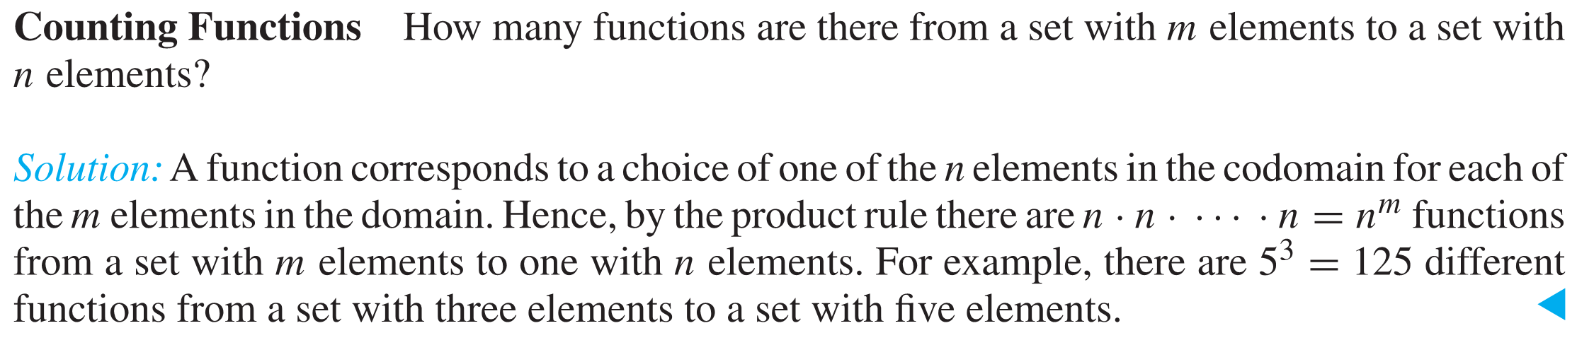
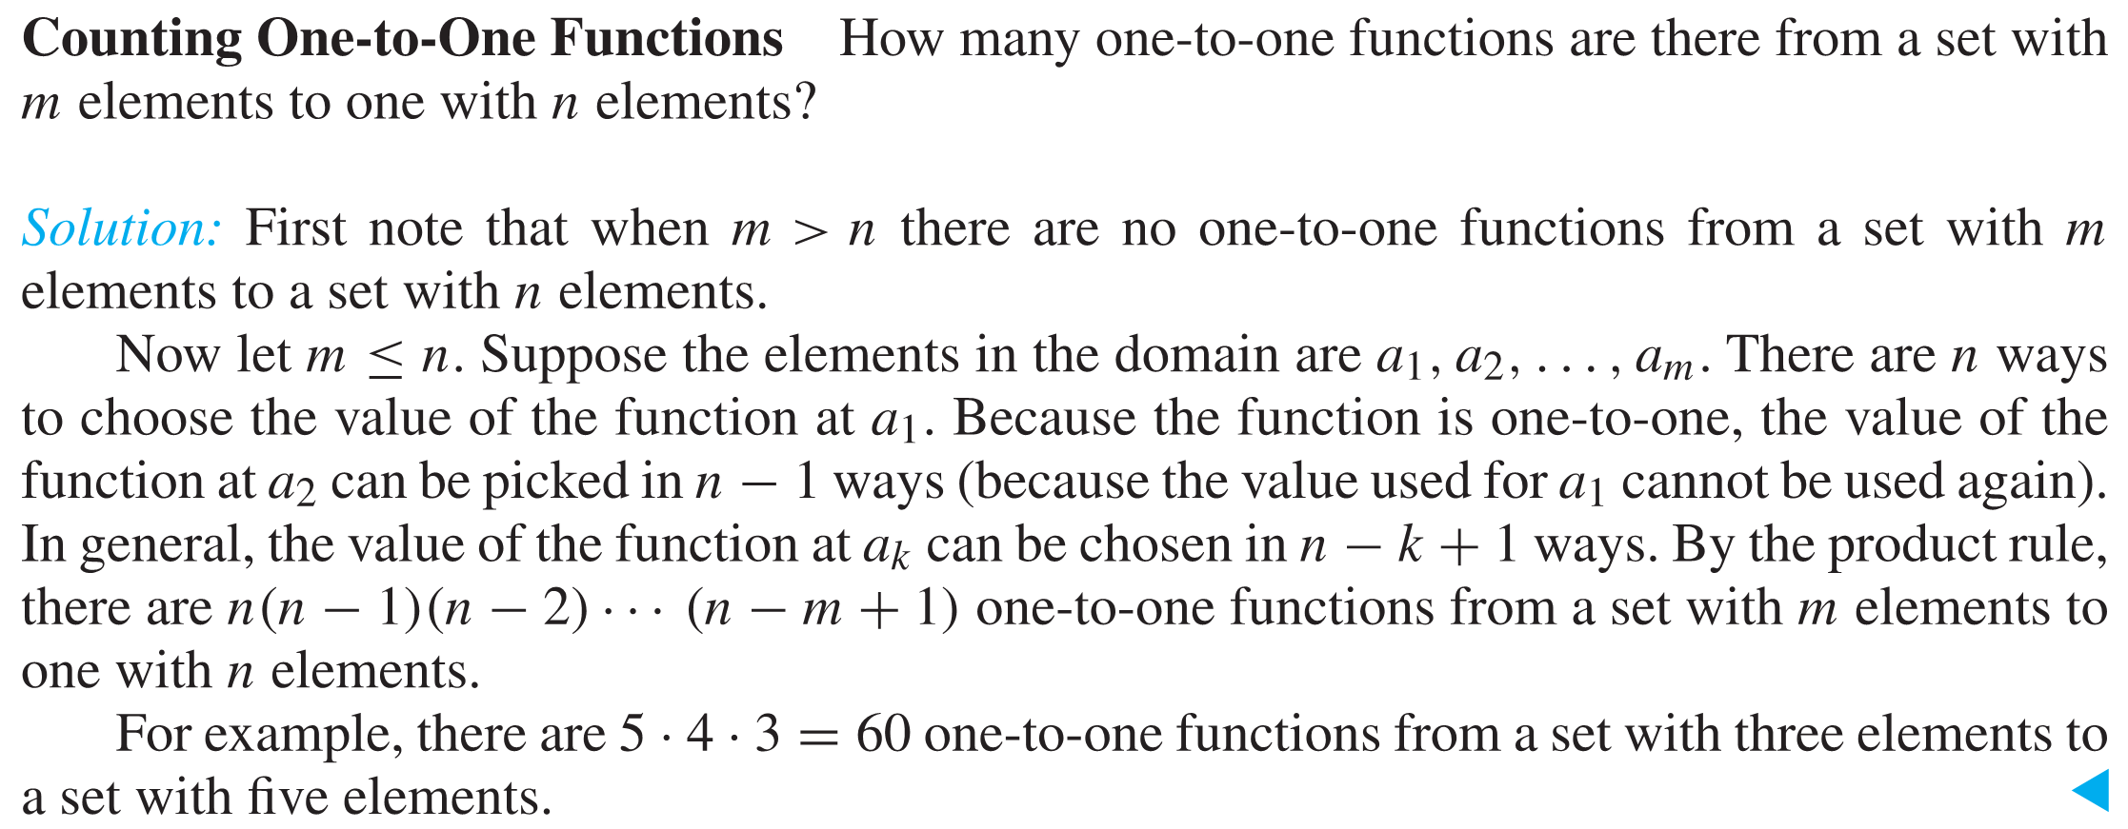
Example 4
Example 5

Slide 6
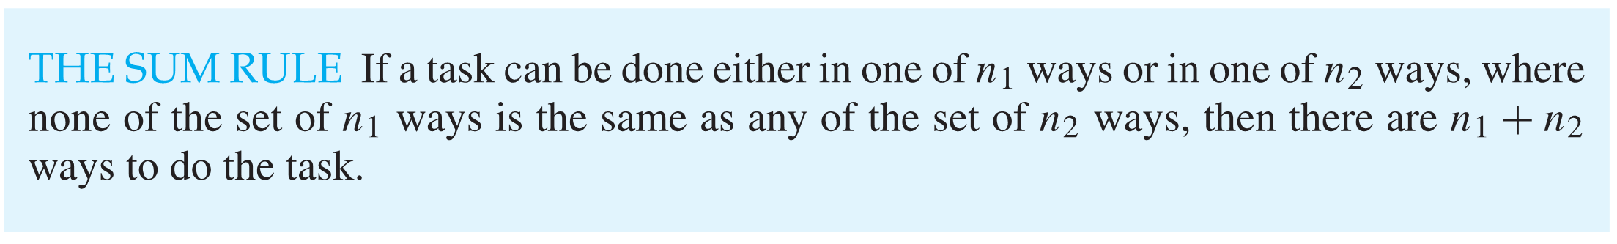
Sum Rule
Example 6
A student can choose a computer project from one of three lists. The three lists contain 23, 15, and 19 possible projects respectively. How many possible projects are there to choose from?
(Solution) The student can choose a project from the first list in 23 ways, from the second list in 15 ways, and from the third list in 19 ways. Hence, there are 23 + 15 + 19 = 57 projects to choose from.

Slide 7
Example 7
A swimming team has 4 athletes who swim backstroke, 3 who swim breaststroke, 3 who swim butterfly, and 5 who swim freestyle. A medley relay consists of one swimmer from each of the four strokes.
(i) How many choices does the coach have for a medley relay?
(ii) How many choices does the coach have for a medley relay if one of the 3 athletes who swim butterfly is also one of the 5 athletes who swim freestyle?
(i) No. of choices = 4 x 3 x 3 x 5 = 180 (product rule)
(ii) We break the problem into 3 disjoint cases and use the
sum rule. Let V denotes the versatile swimmer.
Case 1: V swims butterfly: 4 × 3 × 1 × 4 = 48 (product rule)
Case 2: V swims freestyle: 4 × 3 × 2 × 1 = 24 (…)
Case 3: V swims neither: 4 × 3 × 2 × 4 = 96 (…)
Hence, the number of choices is 48 + 24 + 96 = 168.
7

Slide 8
The Principle of Inclusion-Exclusion
Suppose that a task can be done in one of two ways, but some of the ways to do it are common to both ways. In this situation, we cannot use the sum rule to count the number of ways to do the task. If we add the number of ways to do the tasks in these two ways, we get an overcount of the total number of ways to do it, because the ways to do the task that are common to the two ways are counted twice. To correctly count the number of ways to do the two tasks, we must subtract the number of ways that are counted twice. This leads us to an important counting rule.

Slide 9
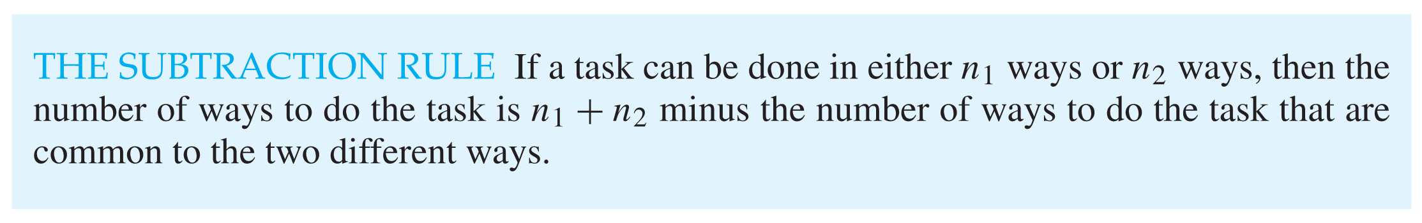
The Subtraction Rule
Suppose that A₁ and A₂ are sets. Then, there are |A₁| ways to select an element from A₁ and |A₂| ways to select an element from A₂. The number of ways to select an element from A₁ or from A₂, that is, the number of ways to select an element from their union, is the sum of the number of ways to select an element from A₁ and the number of ways to select an element from A₂, minus the number of ways to select an element that is in both A₁ and A₂. Because there are |A₁ ∪ A₂|ways to select an element in either A₁ or in A₂, and |A₁ ∩ A₂| ways to select an element common to both sets, we have
|A₁ ∪ A₂|=|A₁|+|A₂|−|A₁ ∩ A₂|.

Slide 10
Example 8
How many bit strings of length eight either start with a 1 bit or end with the two bits 00?
The first task, constructing a bit string of length eight that begins with a 1, can be done in 2⁷ = 128 ways.
The second task, constructing a bit string of length eight that ends with the two bits 00, can be done in 2⁶ = 64 ways.
However, both tasks include those bit strings that begin with a 1 and end with 00. Thus, such bit strings are counted twice, and we must deduct them to eliminate over counting.
The number of ways to construct a bit string that begins with a 1 and ends with 00 is 2⁵ = 32 ways.
Consequently, the number of bit strings of length eight that begin
with a 1 or end with 00, which equals to the number of ways to do
either the first task or the second task, will be 128 + 64 – 32 = 160.
10

Slide 11
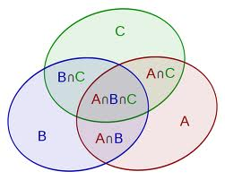
The Subtraction Rule
Suppose we have a task can be done in 3 ways. Let A, B and C denote sets containing the ways to do the task in first, second and third ways, respectively. The total number of ways to do the task is the number of elements in the union of three sets A, B and C.
|A ∪ B ∪ C | = |A| + |B| + |C| - |A ∩ B| - |A ∩ C|- |B ∩ C| + | A ∩ B ∩ C |
11

Slide 12
Example 10
Find the number of students at a university taking at least one of the languages Malay, Mandarin, and Tamil, knowing the following information:
65 study Malay 20 study Malay and Mandarin
45 study Mandarin 25 study Malay and Tamil
42 study Tamil 15 study Mandarin and Tamil
8 study all three languages
We want to find |M ∪ D ∪ T | where M, D, and T denote the sets of students studying Malay, Mandarin, and Tamil, respectively.
12

Slide 13
Solution
By Vann-Diagram:
|M ∪ D ∪ T |=
By the principle of inclusion-exclusion,
|M ∪ D ∪ T | = |M| + |D| + |T| ­ -|M ∩ D| - |M ∩ T| - |D ∩ T|
+ | M ∩ D ∩ T |
= 65 + 45 + 42 – 20 − 25 – 15 + 8 = 100
Malay (M)
17
8
12
Tamil (T)
Mandarin (D)
13

Slide 14
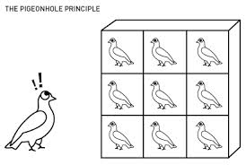
The Pigeonhole Principle
Suppose there are n pigeons, k pigeonholes, and n > k. If these n pigeons fly into these k pigeonholes, then there must be at least one pigeonhole with at least two pigeons in it.
14

Slide 15
Example 11
1) A function f from a set with k + 1 or more elements to a set with k elements is not one-to-one.
Suppose that for each element y in the codomain of f we have a box that contains all elements x of the domain of f such that f(x)= y. Because the domain contains k + 1 or more elements and the codomain contains only k elements, the pigeonhole principle tells us that one of these boxes contains two or more elements x of the domain. This means that f cannot be one-to-one.

Slide 16
Example 11
Use Pigeonhole principle to show that in any group of 27 English words, there must be at least two words that begin with the same letter.
Suppose for each English letter, a box is associated with it and word that begin with that letter will be assigned to the box. As such we have 27 words to be assigned to 26 boxes. By Pigeonhole Principle, there will be at least a box containing at least 2 words. Hence this show that there must be at least two words that begin with the same letter.

Slide 17
The Generalized Pigeonhole Principle
Suppose there are n pigeons, k pigeonholes, n > k, and m = ⎡n / k⎤. If these n pigeons fly into these k pigeonholes, then there is at least one pigeonhole containing at least m pigeons.
Example 12
Among 100 people at least how many people were born in the same month?
Suppose we have a box for each month and people that were born with same month are assigned to the same box.
There are at least ⎡100/12⎤ = 9 who were born in the same month.
17

Slide 18
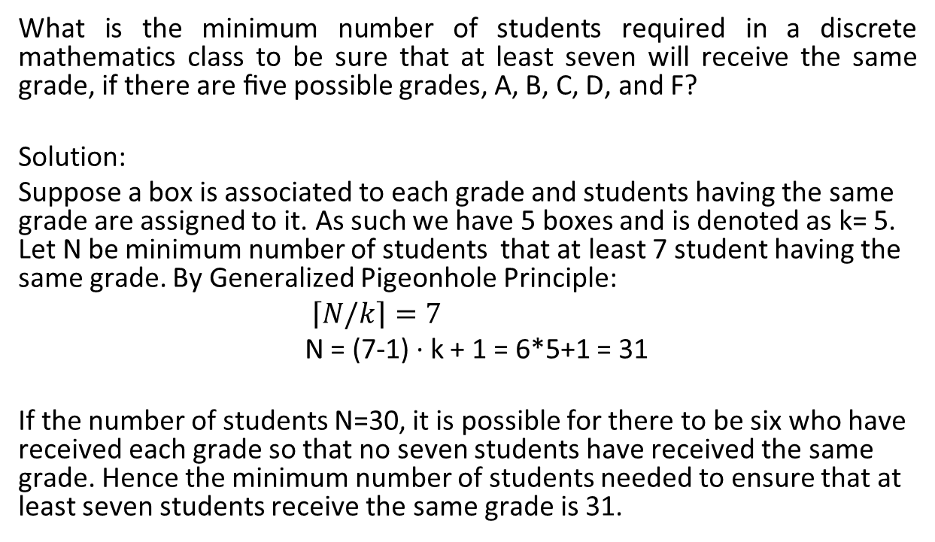
Example 13
What is the minimum number of students required in a discrete mathematics class to be sure that at least seven will receive the same grade, if there are ﬁve possible grades, A, B, C, D, and F?
Solution:
Suppose a box is associated to each grade and students having the same grade are assigned to it. As such we have 5 boxes and is denoted as k= 5. Let N be minimum number of students that at least 7 student having the same grade. By Generalized Pigeonhole Principle:
$\left\lceil N/k\right\rceil =7$
N = (7-1) · k + 1 = 6*5+1 = 31
If the number of students N=30, it is possible for there to be six who have received each grade so that no seven students have received the same grade. Hence the minimum number of students needed to ensure that at least seven students receive the same grade is 31.

Slide 19
Try This
How many cards must be selected from a standard deck of 52 cards to guarantee that at least three cards of the same suit are chosen?
How many must be selected to guarantee that at least three hearts are selected?

Slide 20
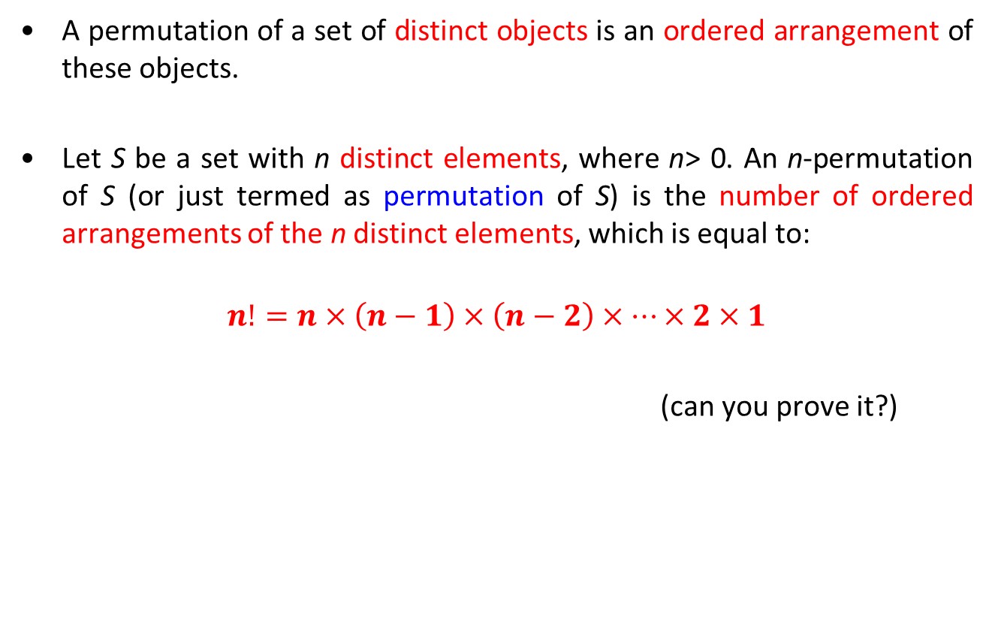
n-Permutations
A permutation of a set of distinct objects is an ordered arrangement of these objects.
Let S be a set with n distinct elements, where n> 0. An n-permutation of S (or just termed as permutation of S) is the number of ordered arrangements of the n distinct elements, which is equal to:
$$n!=n×\left(n−1\right)×\left(n−2\right)×…×2×1$$
(can you prove it?)
20

Slide 21
Example 14
Let S = {1, 2, 3}. The arrangement 1, 2, 3 is a permutation of S. The arrangement 3, 1, 2 is another permutation of S. Altogether there are 3! = 6 permutations of S.
To arrange four persons in a line for a photo session, there are
4! = 24 ways of arrangement.

Slide 22
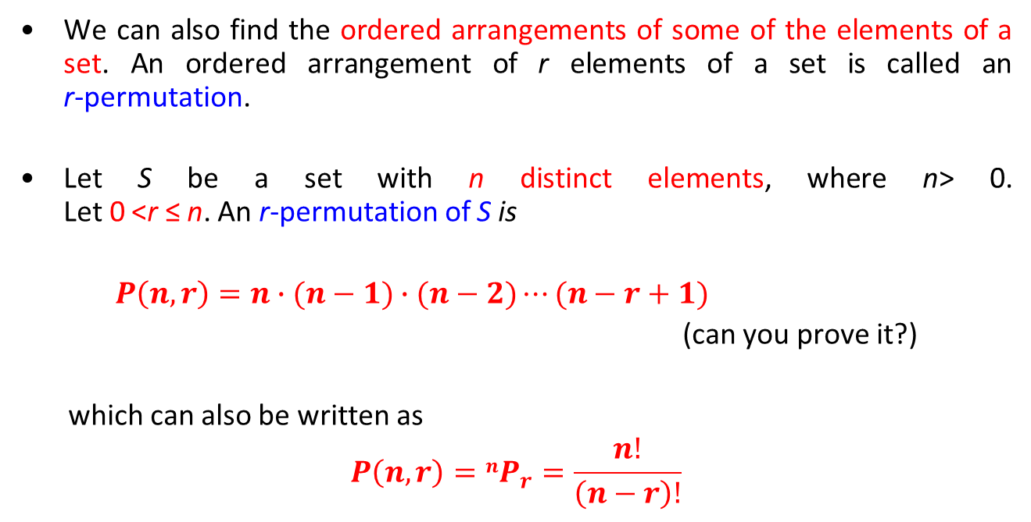
r-Permutations
We can also find the ordered arrangements of some of the elements of a set. An ordered arrangement of r elements of a set is called an r-permutation.
Let S be a set with n distinct elements, where n> 0. Let 0 <r ≤ n. An r-permutation of S is
$P\left(n,r\right)=n∙(n−1)∙(n−2)⋯(n−r+1)$
(can you prove it?)
which can also be written as
$$P\left(n,r\right)=nP_{r}=\frac{n!}{\left(n−r\right)!}$$
22

Slide 23
Example 15
A president and a treasurer are to be chosen from a student club consisting of 5 people, {A, B, C, D, E}. How many different choices of officers are possible if
(i) there are no restrictions.
(ii) A will serve only if he is a president.
(iii) B and C will serve together or not at all.
(iv) D and E will not serve together.
Let n be the number of ways,
(i) There are no restrictions.
n = ⁵P₂ = 20
(ii) A will serve only if he is a president.
n = ⁴P₁ + ⁴P₂ = 16
(iii) B and C will serve together or not at all.
n = 2! + ³P₂ = 8
(iv) D and E will not serve together.
n = 20 − 2! = 18
23

Slide 24
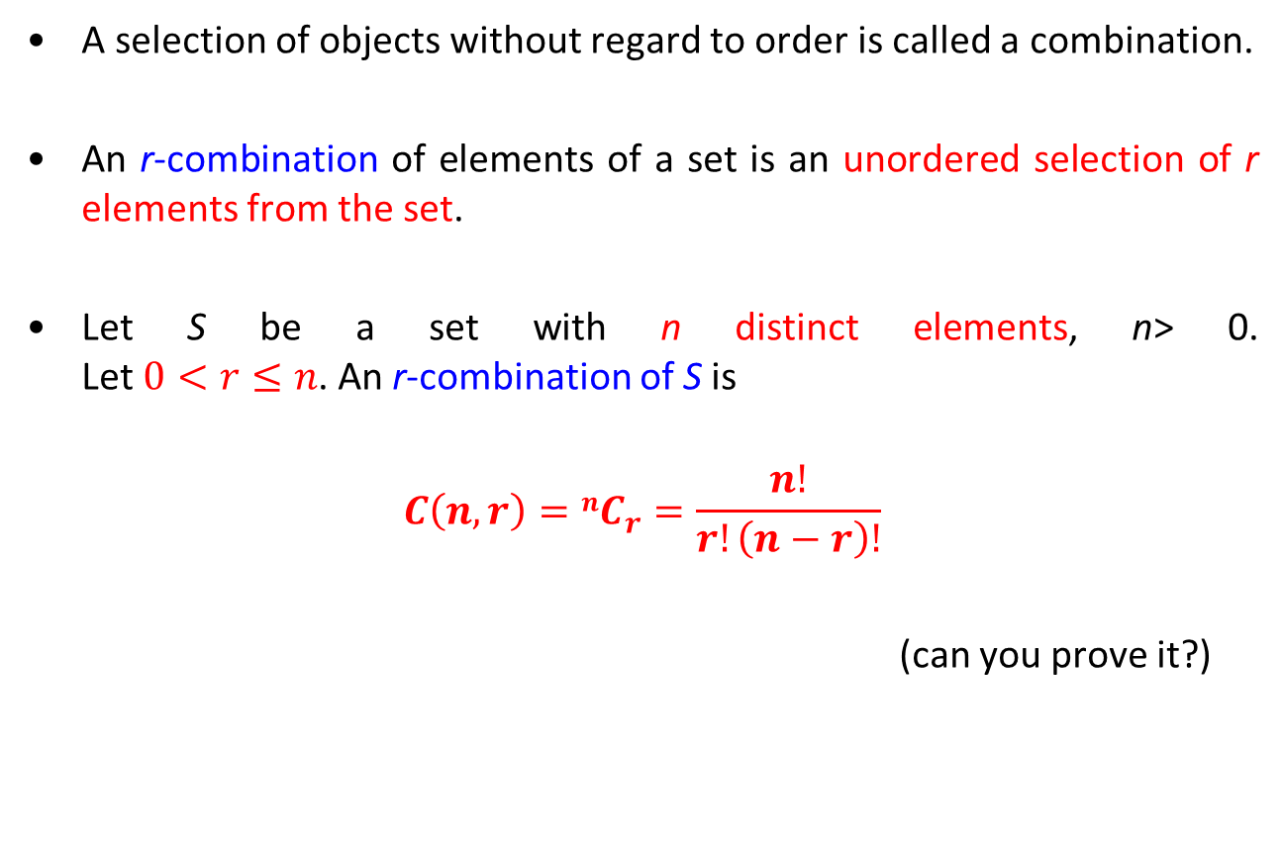
Combinations
A selection of objects without regard to order is called a combination.
An r-combination of elements of a set is an unordered selection of r elements from the set.
Let S be a set with n distinct elements, n> 0. Let $0<r≤n$. An r-combination of S is
$$C\left(n,r\right)=nC_{r}=\frac{n!}{r!\left(n−r\right)!}$$
(can you prove it?)
24

Slide 25
Examples 16
How many ways are there to select four players from a 10-member tennis team to make a trip to a match at another school?
C(10, 4) = 10!/(4!6!) = 210 ways.
In how many ways we can select a committee of two women and three men from a group of five women and six men?
The committee can be formed in two successive steps:
Select the women, then select the men.
To select two women from a group of five: C(5, 2) = 10 ways
To select three men from a group of six: C(6, 3) = 20 ways
Thus, by the multiplication principle, the total number of ways
is 10 × 20 = 200.
25

Slide 26
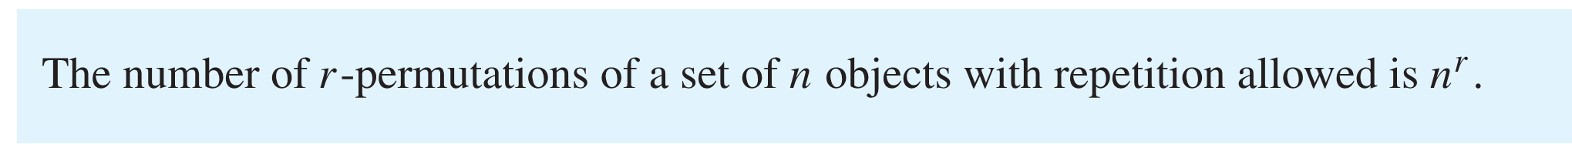
Generalized Permutations and Combinations
Permutations with Repetition
Example 17
How many strings of length r can be formed from the uppercase letters of the English alphabet?
Solution: By the product rule, because there are 26 uppercase English letters, and because each letter can be used repeatedly, we see that there are 26^{r} strings of uppercase English letters of length r.

Slide 27
Combinations with Repetition
Example 18
How many ways are there to select four pieces of fruit from a bowl containing apples, oranges, and pears if the order in which the pieces are selected does not matter, only the type of fruit and not the individual piece matters, and there are at least four pieces of each type of fruit in the bowl?
Solution: To solve this problem we list all the ways possible to select the fruit. There are 15 ways:
4 apples 4 oranges 4 pears
3 apples,1 orange 3 apples, 1 pear 3 oranges, 1 apple
3 oranges, 1 pear 3 pears, 1 apple 3 pears, 1 orange
2 apples, 2 oranges 2 apples, 2 pears 2 oranges, 2 pears
2 apples, 1 orange, 1 pear 2 oranges, 1 apple, 1 pear
2 pears, 1 apple, 1 orange
The solution is the number of 4-combinations with repetition allowed from a three-element set, {apple, orange, pear}.

Slide 28
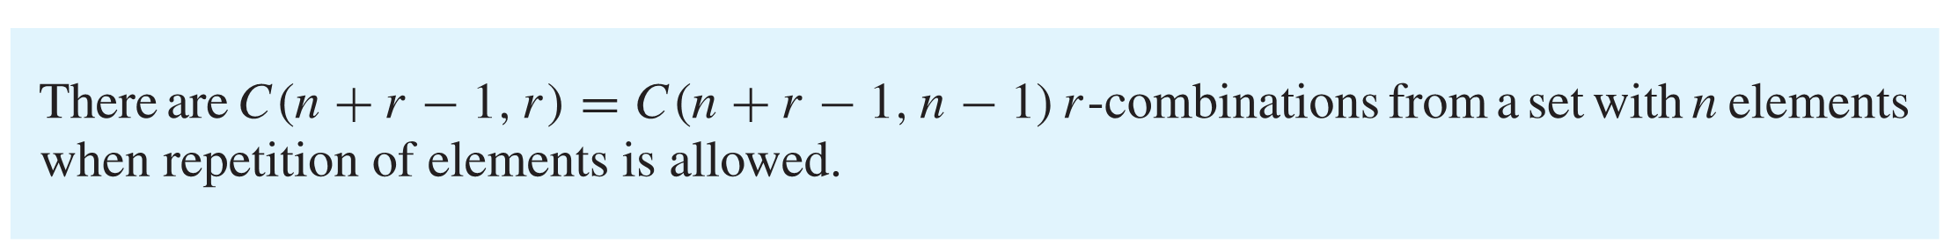
Combinations with Repetition

Slide 29
From Example 18
Imagine that we have 3 containers which are used to keep the selected fruits apple, orange and pear separately. Let “*” denotes a fruit and “|” represent the separator between the containers. In this case 2 separators is required to separate the 3 containers. The ways to select four pieces of fruits from a bowl containing apples, oranges, and pears (where repetition is allowed) can now be represented by a sequence of four “*”s and two “|”s.
For example:
4 apples ****| |
3 oranges,1 pear |***|*
2 pears, 1 apple, 1 orange *|*|**
…
This also means that the total number of ways to select fruits mentioned above is the same as numbers of ways to select four “*” in a row with a total of 6 positions which gives

Slide 30
From Example 18 (Cont.)
Or by using the Theorem
The ways to select four pieces of fruits (r=4) from a bowl containing apples, oranges and pears (n=3) (where repetition is allowed) is

Slide 31
Example 19
How many ways are there to select ﬁve bills from a cash box containing $1 bills, $2 bills, $5 bills, $10 bills? Assume that the order in which the bills are chosen does not matter, that the bills of each denomination are indistinguishable, and that there are at least ﬁve bills of each type.
(Try to solve the problem without using the formula.)

Slide 32
Examples 20
Find the number of integer solutions to the equation
x₁ + x₂ = 3, where x₁ ≥ 0 and x₂ ≥ 0.
(Try to solve the problem without using the formula.)
32

Slide 33
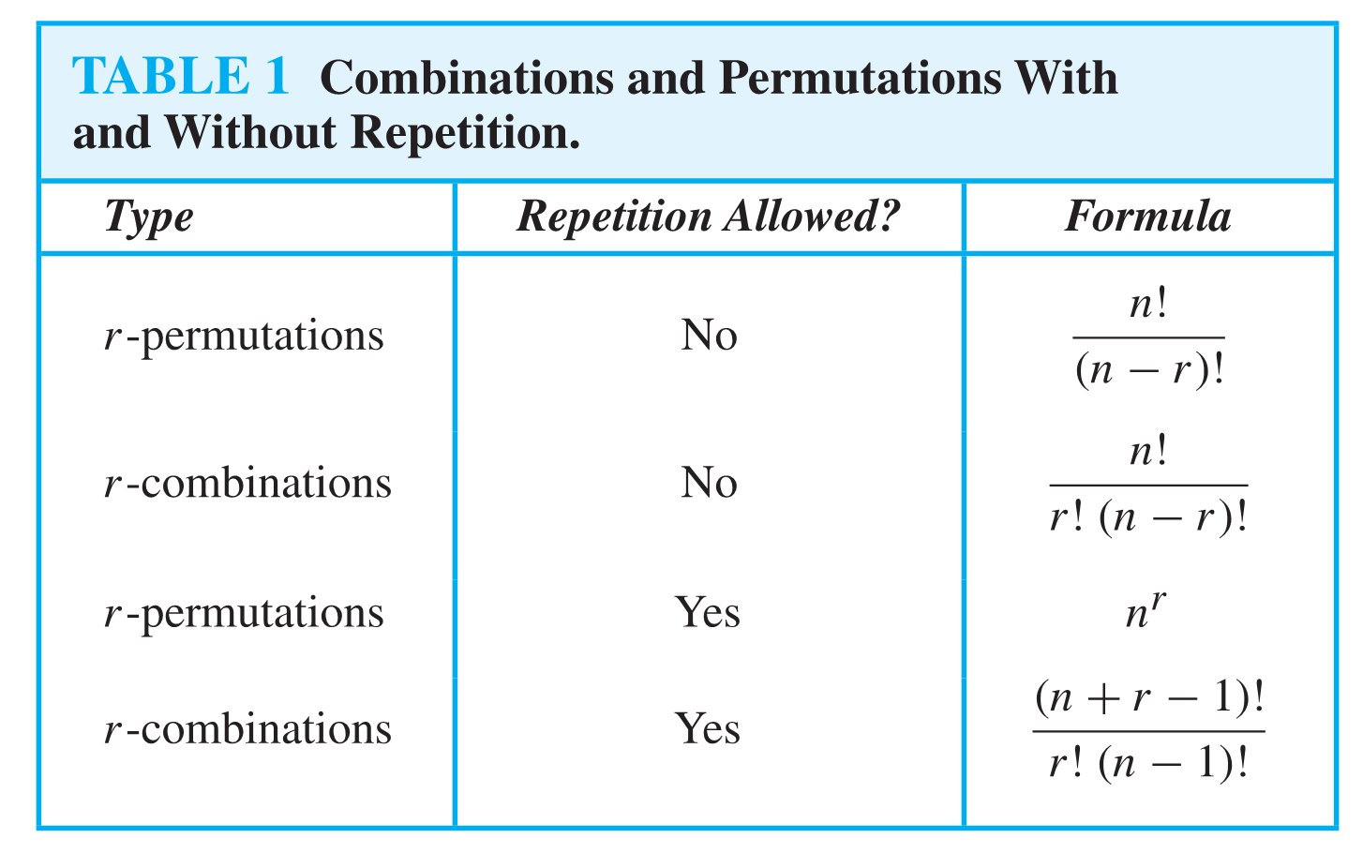

Slide 34

Permutations with Indistinguishable Objects
Suppose that a sequence S of n items has
n₁ identical objects of type 1
n₂ identical objects of type 2
:
:
n_{k} identical objects of type k
Then, the number of orderings of S is
$$\frac{n!}{n_{1}!n_{2}!…n_{k−1}!n_{k}!}$$
34

Slide 35
Example 21
How many different strings can be made by reordering the letters of the word SUCCESS?
Solution: Because some of the letters of SUCCESS are the same, the answer is not given by the number of permutations of seven letters. This word contains three Ss, two Cs, one U, and one E. To determine the number of different strings that can be made by reordering the letters, ﬁrst note that the three Ss can be placed among the seven positions in C(7,3) different ways, leaving four positions free. Then the two Cs can be placed in C(4,2)ways, leaving two free positions. The U can be placed in C(2,1)ways, leaving just one position free. Hence E can be placed in C(1,1) way. Consequently, from the product rule, the number of different strings that can be made is

Slide 36
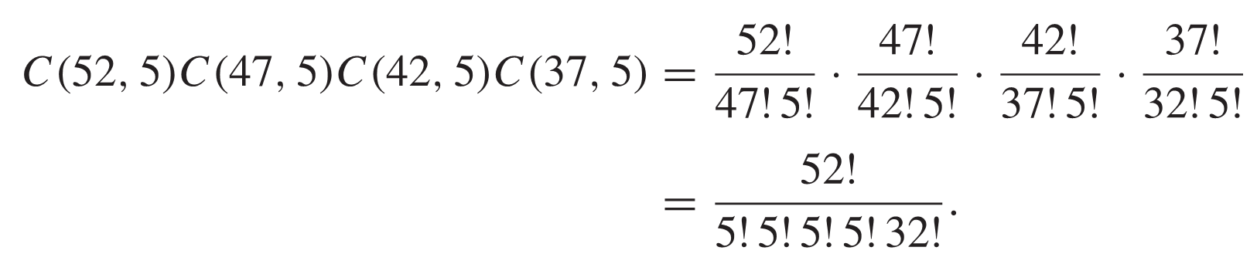
Example 22
How many ways are there to distribute hands of 5 cards to each of four players from the standard deck of 52 cards?
Solution: We will use the product rule to solve this problem. To begin, note that the ﬁrst player can be dealt 5 cards in C(52,5)ways. The second player can be dealt 5 cards in C(47,5)ways, because only 47 cards are left. The third player can be dealt 5 cards in C(42,5) ways. Finally, the fourth player can be dealt 5 cards in C(37,5)ways. Hence, the total number of ways to deal four players 5 cards each is

Slide 37
Summary
Materials covered in this lecture:
The addition principle
The multiplication principle
The principle of inclusion-exclusion
Pigeonhole principle
Generalized pigeonhole principle
n-Permutations
r-Permutations
Combinations
Generalized permutations
Generalized combinations
37

Slide 38
Exercise 1
There are 6 flavors of ice-cream, and 3 different cones. How many different single-scoop ice-creams you could order?
38

Slide 39
Exercise 2
A student can choose a computer project from one of three lists. The three lists contain 23, 15 and 19 possible projects, respectively. How many possible projects are there to choose from?
39

Slide 40
Exercise 3
How many integers from 1 to 100 are either multiples of 3 or multiples of 5?
40

Slide 41
Exercise 4
Among 18 students in a room, 7 study mathematics, 10 study science, and 10 study computer programming. Also, 3 study mathematics and science, 4 study mathematics and computer programming, and 5 study science and computer programming. We know that 1 student studies all three subjects. How many of these students study none of the three subjects?
41

Slide 42
Exercise 5
How many students in a class must there be to ensure that there are at least 6 students get the same grade (A, B, C, D, or E)?
42

Slide 43
Exercise 6
In how many ways can a photographer at a wedding arrange six people in a row, including the bride and groom if the bride must be next to the groom?
43

Slide 44
Exercise 7
3 marbles are drawn at random from a bag containing 3 red and 5 white marbles. How many different draws would contain 1 red and 2 white marbles?
44

Slide 45
Exercise 8
Suppose that a cookie shop has four different kinds of cookies. How many different ways can six cookies be chosen? Assume that only the type of cookie, and not the individual cookies or the order in which they are chosen, matters.
45

